Slide 1


    Periodic Pattern Mining
Philippe Fournier-Viger
http://www.philippe-Fournier-viger.com
Source code and datasets available in the SPMF library
Notes:
Fournier-Viger, P., Wu, C.-W., Gomariz, A., Tseng, V. S. (2014). VMSP: Efficient Vertical Mining of Maximal Sequential Patterns. Proc. 27th Canadian Conference on Artificial Intelligence (AI 2014), Springer, LNAI, pp. 83-94.
It’s not really about « APPLICATIONS OF AI »

Slide 2
Introduction
Many algorithms have been proposed to discover interesting patterns in data.
A popular task is frequent itemset mining.
The goal is to find sets of values that are frequently appearing together in data.
However, a limitation is that the time is ignored.
Today, I will talk of extension to consider time, called periodic pattern mining.
{tomato, wine, cheese}

Slide 3



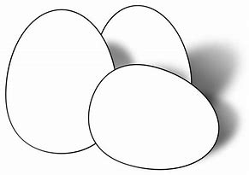

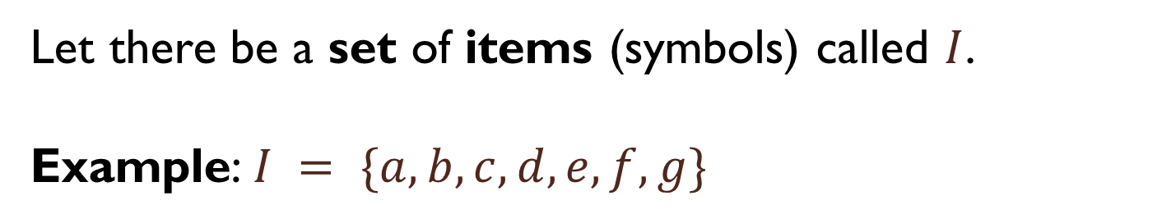

Frequent Itemset Mining
Let there be a set of items (symbols) called $I$.
Example: $I = \{a,b,c,d,e, f,g\}$
$a$ = apple $d$ = dattes
$b$ = bread $e$ e= eggs
$c$= cake

Slide 4
Frequent Itemset Mining
Let there be a numerical value minsup >0, set by the user.
Frequent itemset mining (FIM) consists of enumerating all frequent itemsets, that is itemsets having a support greater or equal to minsup.
Transaction | Items appearing in the transaction
T1 | {a, b, c, d}
T2 | {a, b}
T3 | {a, d, e}
T4 | {a, b, d, e}

Slide 5
Example
a= a, b = b c = c d= d e = b
Transaction | Items appearing in the transaction
T1 | {a, b, c, d}
T2 | {a, b}
T3 | {a, d, e}
T4 | {a, b, d, e}
For minsup = 2, the frequent itemsets are:
{b}, {a}, {d}, {e}, {a,b}, {b, d}, {a, d}, {a, e}, {d, e}, {a, b, d}
For the user, choosing a high minsup value,
will reduce the number of frequent itemsets,
will increase the speed and decrease the memory required for finding the frequent itemsets

Slide 6
This is useful but…
What about the time dimension?
Customer behavior can change over time or show some regularities.
Several types of patterns with time:
  periodic patterns,
  peak patterns,
  trending patterns,
  etc.
Today we will talk about the periodic patterns.

Slide 7
Periodic Itemset Mining
Goal: find groups of items that appear periodically in a sequence of transactions.
Example:
{baguette, cheese, orange juice} may be a frequent periodic pattern for a customer, occurring every week.

Slide 8
The traditional problem
The PF-Growth algorithm (Tanbeer, 2009)
Input: a transaction database:
and parameters maxPer>0 and minsup >0
Output: all the frequent periodic patterns
Transaction | Items
T₁ | {a, c}
T₂ | {e}
T₃ | {a,b,c,d,e}
T₄ | {b,c,d,e}
T₅ | {a,c,d}
T₆ | {a,c,e}
T₇ | {b,c,e}

Slide 9
Definition: Periodicity
A transaction database
Transaction | Items
T₁ | {a, c}
T₂ | {e}
T₃ | {a,b,c,d,e}
T₄ | {b,c,d,e}
T₅ | {a,c,d}
T₆ | {a,c,e}
T₇ | {b,c,e}
Periods of an itemset:
the number of transactions between each occurrence of the itemset
Example:
The periods of the itemset {a,c}) are
ps({a,c}) = ?

Slide 10
Definition: Periodicity
A transaction database
Transaction | Items
T₁ | {a, c}
T₂ | {e}
T₃ | {a,b,c,d,e}
T₄ | {b,c,d,e}
T₅ | {a,c,d}
T₆ | {a,c,e}
T₇ | {b,c,e}
Periods of an itemset:
the number of transactions between each occurrence of the itemset
Example:
The periods of the itemset {a,c}) are
ps({a,c}) = {1 …}
1

Slide 11
Definition: Periodicity
A transaction database
Transaction | Items
T₁ | {a, c}
T₂ | {e}
T₃ | {a,b,c,d,e}
T₄ | {b,c,d,e}
T₅ | {a,c,d}
T₆ | {a,c,e}
T₇ | {b,c,e}
Periods of an itemset:
the number of transactions between each occurrence of the itemset
Example:
The periods of the itemset {a,c}) are
ps({a,c}) = {1,2 …}
1
2

Slide 12
Definition: Periodicity
A transaction database
Transaction | Items
T₁ | {a, c}
T₂ | {e}
T₃ | {a,b,c,d,e}
T₄ | {b,c,d,e}
T₅ | {a,c,d}
T₆ | {a,c,e}
T₇ | {b,c,e}
Periods of an itemset:
the number of transactions between each occurrence of the itemset
Example:
The periods of the itemset {a,c}) are
ps({a,c}) = {1,2,2 …}
1
2
2

Slide 13
Definition: Periodicity
A transaction database
Transaction | Items
T₁ | {a, c}
T₂ | {e}
T₃ | {a,b,c,d,e}
T₄ | {b,c,d,e}
T₅ | {a,c,d}
T₆ | {a,c,e}
T₇ | {b,c,e}
Periods of an itemset:
the number of transactions between each occurrence of the itemset
Example:
The periods of the itemset {a,c}) are
ps({a,c}) = {1,2,2,1 …}
1
2
2
1

Slide 14
Definition: Periodicity
A transaction database
Transaction | Items
T₁ | {a, c}
T₂ | {e}
T₃ | {a,b,c,d,e}
T₄ | {b,c,d,e}
T₅ | {a,c,d}
T₆ | {a,c,e}
T₇ | {b,c,e}
Periods of an itemset:
the number of transactions between each occurrence of the itemset
Example:
The periods of the itemset {a,c}) are
ps({a,c}) = {1,2,2,1,1}
1
2
2
1
1

Slide 15
Definition: Maximum periodicity
A transaction database
Transaction | Items
T₁ | {a, c}
T₂ | {e}
T₃ | {a,b,c,d,e}
T₄ | {b,c,d,e}
T₅ | {a,c,d}
T₆ | {a,c,e}
T₇ | {b,c,e}
Maximum periodicity:
The maximum periodicity of an itemset X is the maximum of its periods
maxPer(X) = max(ps(X))
1
2
2
1
1

Slide 16
Definition: Maximum periodicity
A transaction database
Transaction | Items
T₁ | {a, c}
T₂ | {e}
T₃ | {a,b,c,d,e}
T₄ | {b,c,d,e}
T₅ | {a,c,d}
T₆ | {a,c,e}
T₇ | {b,c,e}
Maximum periodicity:
The maximum periodicity of an itemset X is the maximum of its periods
maxPer(X) = max(ps(X))
Example:
The periods of the itemset {a,c}) are
ps({a,c}) = {1,2,2,1,1}
maxPer(X) = max({1,2,2,1,1}) = 2
1
2
2
1
1

Slide 17
Definition: Periodic Itemset
A transaction database
Transaction | Items
T₁ | {a, c}
T₂ | {e}
T₃ | {a,b,c,d,e}
T₄ | {b,c,d,e}
T₅ | {a,c,d}
T₆ | {a,c,e}
T₇ | {b,c,e}
Periodic itemset
An itemset X is periodic if
maxPer(X) ≤ maxPer
1
2
2
1
1

Slide 18
Definition: Periodic Itemset
A transaction database
Transaction | Items
T₁ | {a, c}
T₂ | {e}
T₃ | {a,b,c,d,e}
T₄ | {b,c,d,e}
T₅ | {a,c,d}
T₆ | {a,c,e}
T₇ | {b,c,e}
Periodic itemset
An itemset X is periodic if
maxPer(X) ≤ maxPer
Example:
The periods of the itemset
maxPer({a,c}) = 2
1
2
2
1
1

Slide 19
Definition: Periodic Itemset
A transaction database
Transaction | Items
T₁ | {a, c}
T₂ | {e}
T₃ | {a,b,c,d,e}
T₄ | {b,c,d,e}
T₅ | {a,c,d}
T₆ | {a,c,e}
T₇ | {b,c,e}
Periodic itemset
An itemset X is periodic if
maxPer(X) ≤ maxPer
Example:
The periods of the itemset
maxPer({a,c}) = 2
If maxPer = 3 then {a,c} is periodic
1
2
2
1
1

Slide 20
Definition: Periodic Itemset
A transaction database
Transaction | Items
T₁ | {a, c}
T₂ | {e}
T₃ | {a,b,c,d,e}
T₄ | {b,c,d,e}
T₅ | {a,c,d}
T₆ | {a,c,e}
T₇ | {b,c,e}
Periodic itemset
An itemset X is periodic if
maxPer(X) ≤ maxPer
Example:
The periods of the itemset
maxPer({a,c}) = 2
If maxPer = 1 then {a,c} is NOT periodic
1
2
2
1
1

Slide 21
Example
Input:
Transaction database
Transaction | Items
T₁ | {a, c}
T₂ | {e}
T₃ | {a,b,c,d,e}
T₄ | {b,c,d,e}
T₅ | {a,c,d}
T₆ | {a,c,e}
T₇ | {b,c,e}
minsup = 3
maxPer = 3

Slide 22
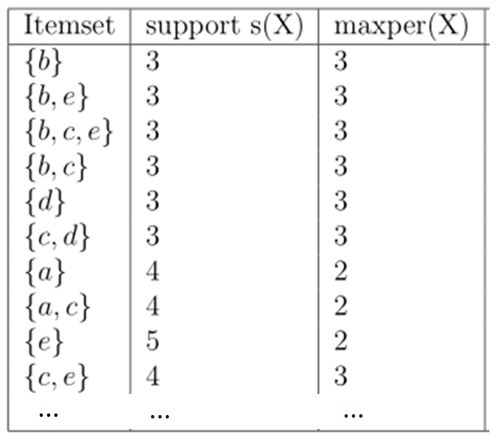
Example
Input:
Transaction database
Output:
Periodic Frequent Itemsets
Transaction | Items
T₁ | {a, c}
T₂ | {e}
T₃ | {a,b,c,d,e}
T₄ | {b,c,d,e}
T₅ | {a,c,d}
T₆ | {a,c,e}
T₇ | {b,c,e}
minsup = 3
maxPer = 3

Slide 23
How to find the periodic itemsets?
Basic algorithms:
  PF-Growth : based on FPGrowth (Tanbeer, 2009)
  MTKPP: based on Eclat (Amphawan, 2009)
The key property used by these algorithms to reduce the search space:
« If an itemset X is not periodic, then any superset Y of X is also not periodic »

Slide 24
But there is a problem…
The definition of periodic pattern is too strict.
If an itemset is always periodic but only exceed the maxPer threshold once, it will be discarded!

Slide 25
A more general model
The PFPM algorithm (Fournier-Viger, 2016)
Periodic itemset: An itemset X is periodic if:
  minAvg ≤ avgper(X) ≤ maxAvg
  Minper(X) ≥ minPer
  Maxper(X) ≤ maxper
  where minAvg, maxAvg, minPer, maxPer are parameters set by the user.

Slide 26
A more general model
The PFPM algorithm (Fournier-Viger, 2016)
Transaction | Items
T₁ | {a, c}
T₂ | {e}
T₃ | {a,b,c,d,e}
T₄ | {b,c,d,e}
T₅ | {a,c,d}
T₆ | {a,c,e}
T₇ | {b,c,e}
Consider the itemset {a,c}
This is the main idea. There are some special cases (see the PFPM paper)

Slide 27
A more general model
The PFPM algorithm (Fournier-Viger, 2016)
Transaction | Items
T₁ | {a, c}
T₂ | {e}
T₃ | {a,b,c,d,e}
T₄ | {b,c,d,e}
T₅ | {a,c,d}
T₆ | {a,c,e}
T₇ | {b,c,e}
Consider the itemset {a,c}
The periods of the itemset {a,c}) are
ps({a,c}) = {1,2,2,1,1}
This is the main idea. There are some special cases (see the PFPM paper)

Slide 28
A more general model
The PFPM algorithm (Fournier-Viger, 2016)
Transaction | Items
T₁ | {a, c}
T₂ | {e}
T₃ | {a,b,c,d,e}
T₄ | {b,c,d,e}
T₅ | {a,c,d}
T₆ | {a,c,e}
T₇ | {b,c,e}
Consider the itemset {a,c}
The periods of the itemset {a,c}) are
ps({a,c}) = {1,2,2,1,1}
maxPer(X) = max({1,2,2,1,1}) = 2
minPer(X) = max({1,2,2,1,1}) = 1
avgPer(X) = ({1,2,2,1,1}) = 1.4
This is the main idea. There are some special cases (see the PFPM paper)

Slide 29
Example
Input:
Transaction database
Transaction | Items
T₁ | {a, c}
T₂ | {e}
T₃ | {a,b,c,d,e}
T₄ | {b,c,d,e}
T₅ | {a,c,d}
T₆ | {a,c,e}
T₇ | {b,c,e}
minPer = 1 minAvg = 1
maxPer = 3 maxAvg = 2

Slide 30
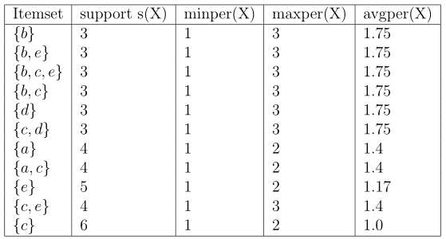
Example
Input:
Transaction database
Output:
Periodic Itemsets
Transaction | Items
T₁ | {a, c}
T₂ | {e}
T₃ | {a,b,c,d,e}
T₄ | {b,c,d,e}
T₅ | {a,c,d}
T₆ | {a,c,e}
T₇ | {b,c,e}
minPer = 1 minAvg = 1
maxPer = 3 maxAvg = 2

Slide 31
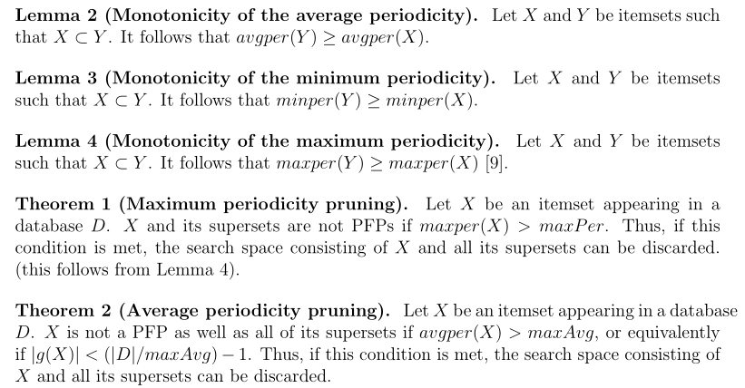
The PFPM algorithm
We don’t want to test all the possible itemsets. The search space is huge. Two theorems are used for pruning the search space.

Slide 32
The PFPM algorithm
PFPM : an algorithm based on ECLAT
It performs a depth-first search.
  It starts with single items {a}, {b}, {c}, {d}…
  Then, the algorithm recursively appends items to to generate larger itemsets:
  {a,b}, {a,b,c}, {a,b,c,d}…. {a,b,d}…
  To reduce the search space, the pruning Theorems 1 and 2 are applied.

Slide 33
The PFPM algorithm (cont’d)
Similarlty to Eclat, PFPM annotates each itemset with its list of transactions (tid-list)
e.g. the tid-list of {a,c} is T_{1,}T_{3,} T_{5,} T₆
This allows quickly calculating the periods of any itemset (see the paper for details)

Slide 34
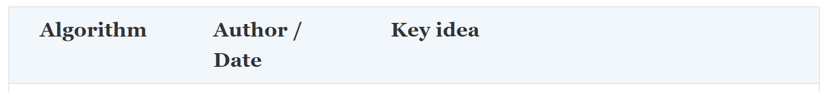
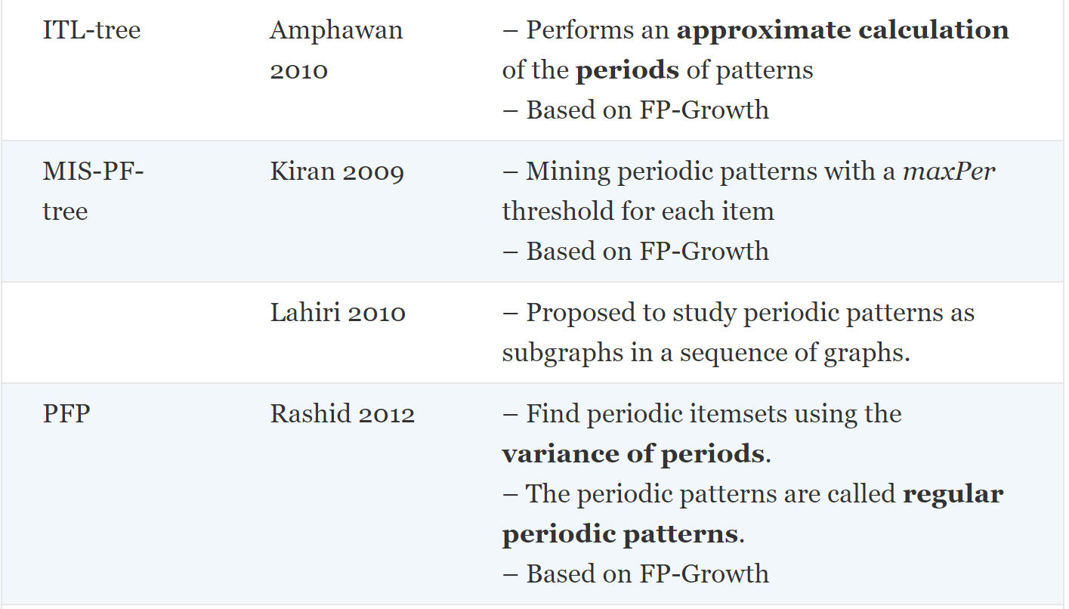
Other interesting papers

Slide 35
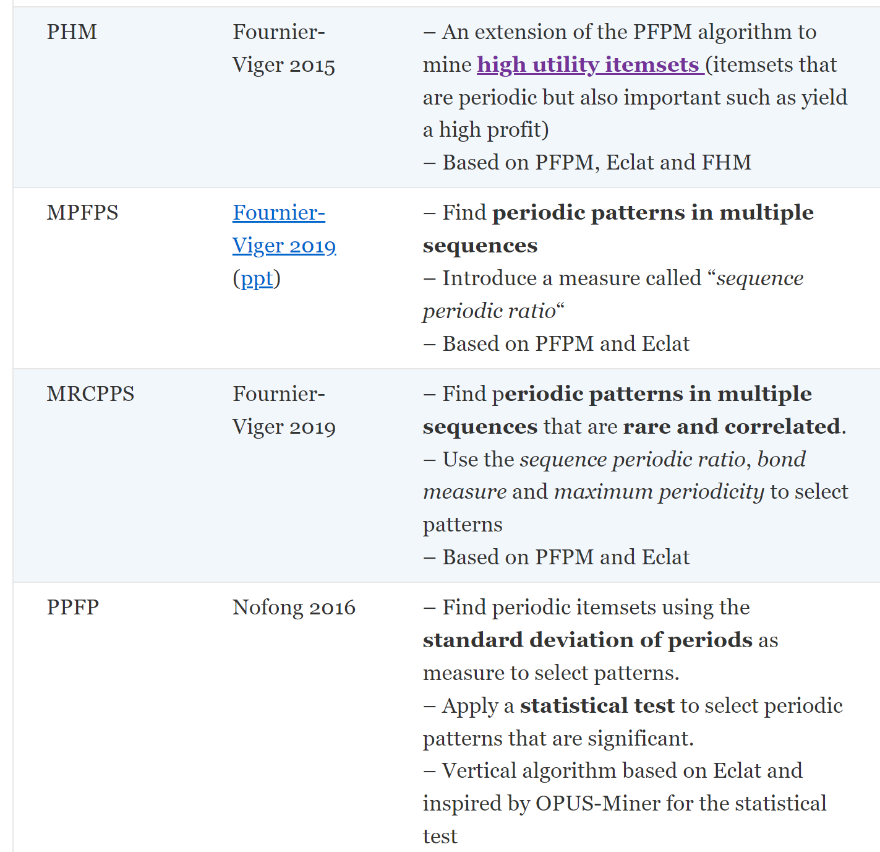
Other interesting papers

Slide 36
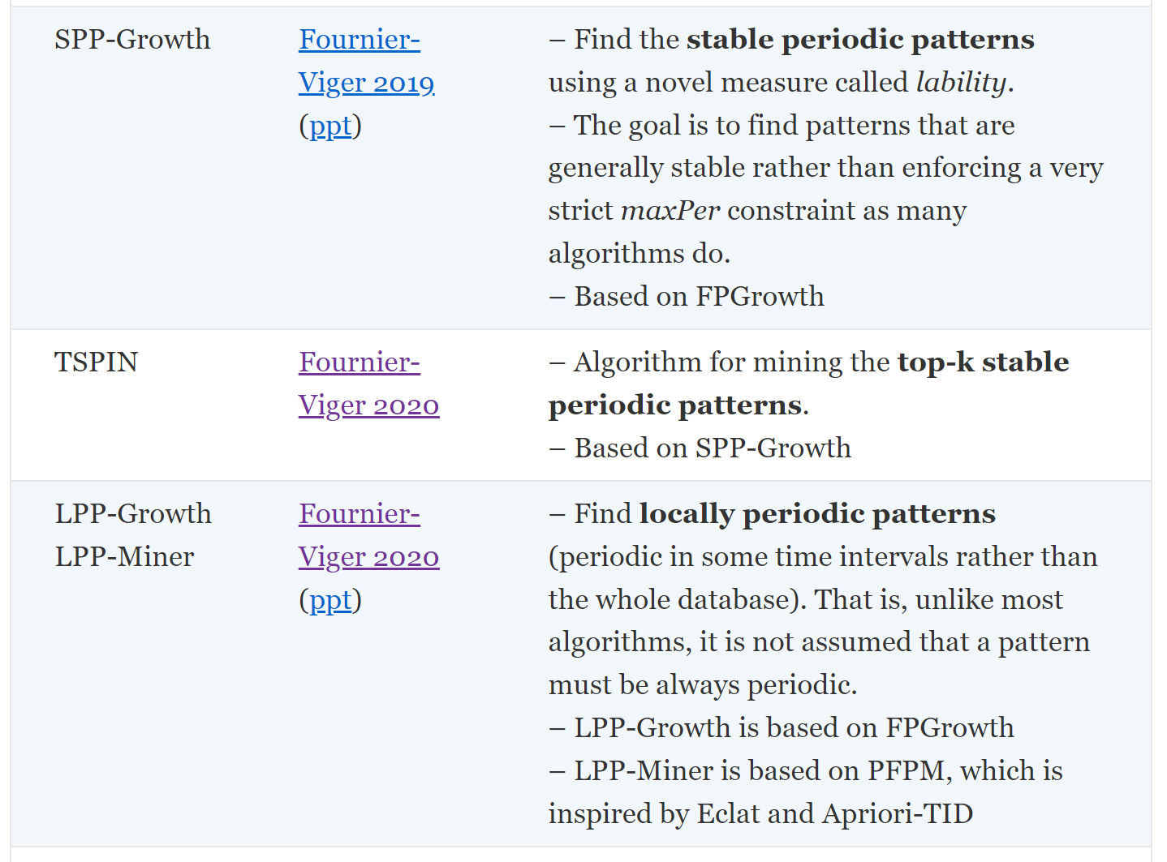
Other interesting papers
Stable
time
Unstable
time

Slide 37
Other interesting papers
Stable
time
Time interval where the pattern is locally periodic

Slide 38

Conclusion
An overview of periodic itemset mining
The traditional problem
The more general problem and the PFPM algorithm
Some other interesting papers
Open source Java data mining software, 240 algorithms
http://www.phillippe-fournier-viger.com/spmf/

